Slide 1


Experimental diachronics: Investigating language change and evolution in the lab
James Brand
j.brand@lancaster.ac.uk

Slide 2
Overview
Experimental diachronics
Outline
What you will learn today:
What language change and evolution is
Why we study it
How to study it
What studying it has shown us
Why multi-disciplinary research is important

Slide 3
Overview
Experimental diachronics
What is language evolution?
Darwin (1837)

Slide 4
Overview
Experimental diachronics
What is language evolution?
Schleicher (1863)

Slide 5
Overview
Experimental diachronics
What is language evolution?
Gray et al., 2010

Slide 6
Motivations
Experimental diachronics
Why study language evolution?
http://www.nytimes.com/2007/11/01/science/01chimp.html
Notes:
Human unique language – no other communication system in animals

Slide 7
Motivations
Experimental diachronics
Why study language evolution?
Rise of the Planet of the Apes (2011)

Slide 8
Motivations
Experimental diachronics
Why study language evolution?
haha
lol
aaaaaa
*grunt*
$%£#

Slide 9
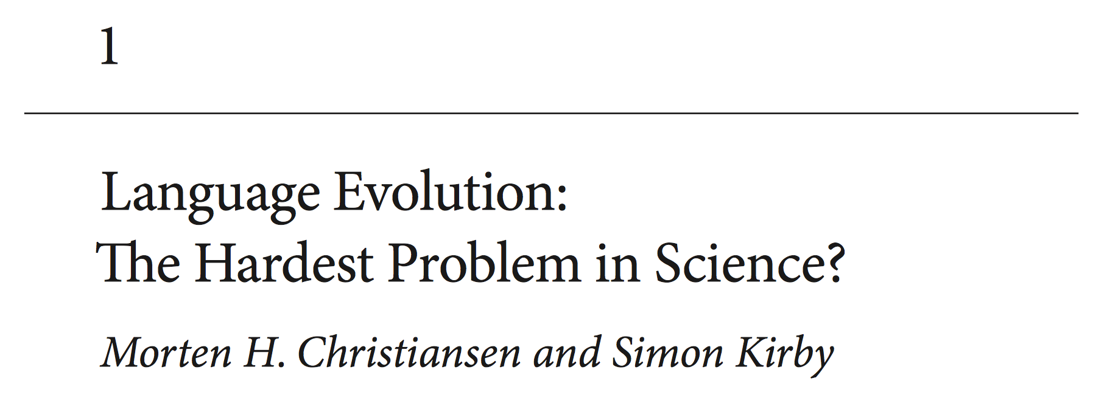
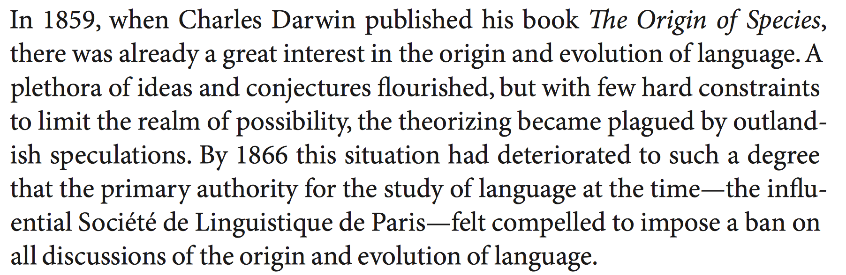
Motivations
Experimental diachronics
Why study language evolution?
Christiansen & Kirby (2003)

Slide 10
Methods
Experimental diachronics
How to study language evolution
https://startlediguana.files.wordpress.com/2013/10/boule_skulls.gif

Slide 11
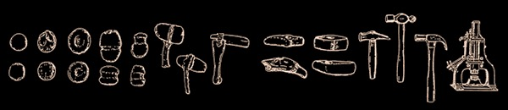
Methods
Experimental diachronics
How to study language evolution
Basalla (1988)

Slide 12
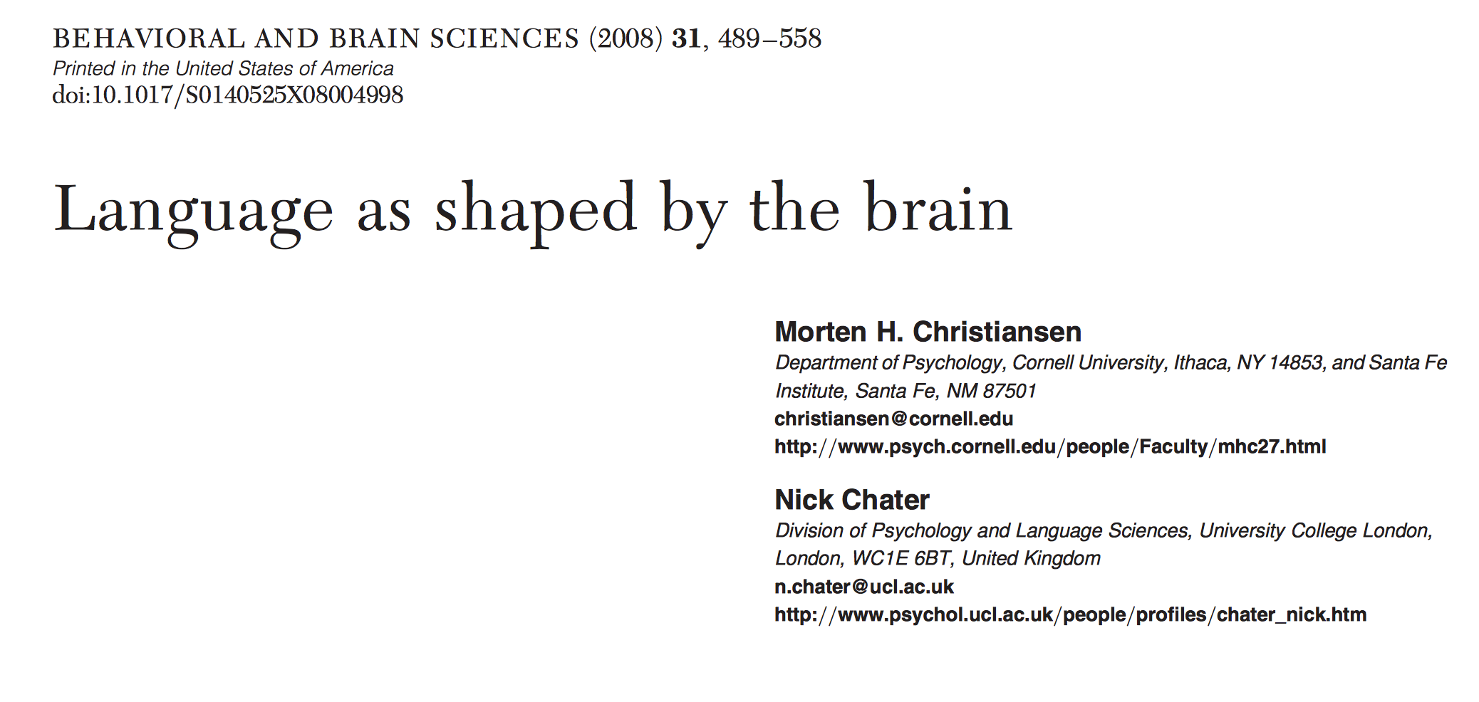
Methods
Experimental diachronics
How to study language evolution
Christiansen & Chater (2008)
Notes:
Evolution of cognition – leads to learning biases Learning biases shape culture

Slide 13
Methods
Experimental diachronics
How to study language evolution
Notes:
Evolution of cognition – leads to learning biases Learning biases shape culture

Slide 14
Methods
Experimental diachronics
How to study language evolution
1 8 5 0 3 7 6 2 4 9
Notes:
Evolution of cognition – leads to learning biases Learning biases shape culture

Slide 15
Methods
Experimental diachronics
How to study language evolution
Notes:
Evolution of cognition – leads to learning biases Learning biases shape culture

Slide 16
Methods
Experimental diachronics
How to study language evolution
0 1 2 3 4 5 6 7 8 9
Notes:
Evolution of cognition – leads to learning biases Learning biases shape culture

Slide 17
Methods
Experimental diachronics
How to study language evolution
Notes:
Evolution of cognition – leads to learning biases Learning biases shape culture

Slide 18
Methods
Experimental diachronics
How to study language evolution
icuetfsogrisoslimsncmhlou
Notes:
Evolution of cognition – leads to learning biases Learning biases shape culture

Slide 19
Methods
Experimental diachronics
How to study language evolution
Notes:
Evolution of cognition – leads to learning biases Learning biases shape culture

Slide 20
Methods
Experimental diachronics
How to study language evolution
summerschooloflinguistics
Notes:
Evolution of cognition – leads to learning biases Learning biases shape culture

Slide 21
Methods
Experimental diachronics
How to study language evolution
Notes:
Evolution of cognition – leads to learning biases Learning biases shape culture

Slide 22
Methods
Experimental diachronics
How to study language evolution
http://www.replicatedtypo.com/iterated-learning-using-youtube-videos/6093.html
Notes:
Evolution of cognition – leads to learning biases Learning biases shape culture

Slide 23
Methods
Experimental diachronics
How to study language evolution
Arrival (2016)
Notes:
Evolution of cognition – leads to learning biases Learning biases shape culture

Slide 24
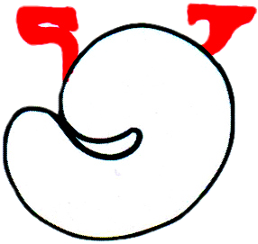
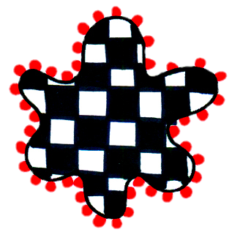
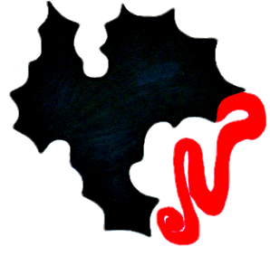
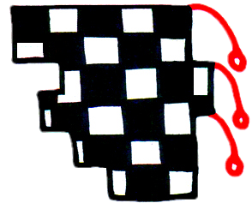
Methods
Experimental diachronics
How to study language evolution
gahemi
hekipo
kilonu
lenoga
Brand & Monaghan (in prep)
Notes:
Evolution of cognition – leads to learning biases Learning biases shape culture

Slide 25
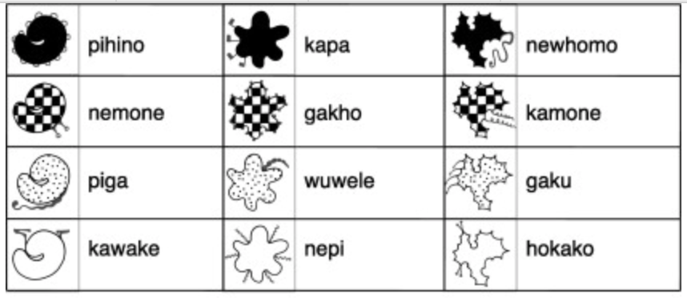
Methods
Experimental diachronics
How to study language evolution
Generation 1
Kirby, Tamariz, Cornish & Smith (2015)
Notes:
Evolution of cognition – leads to learning biases Learning biases shape culture

Slide 26
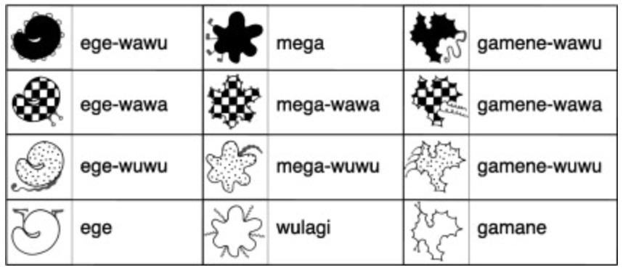
Methods
Experimental diachronics
How to study language evolution
Generation 10
Kirby, Tamariz, Cornish & Smith (2015)
Notes:
Evolution of cognition – leads to learning biases Learning biases shape culture

Slide 27
Methods
Experimental diachronics
How to study language evolution
Fehér et al (2017)
Notes:
Evolution of cognition – leads to learning biases Learning biases shape culture

Slide 28
Methods
Experimental diachronics
How to study language evolution
Claidière et al (2014)
Notes:
Evolution of cognition – leads to learning biases Learning biases shape culture

Slide 29
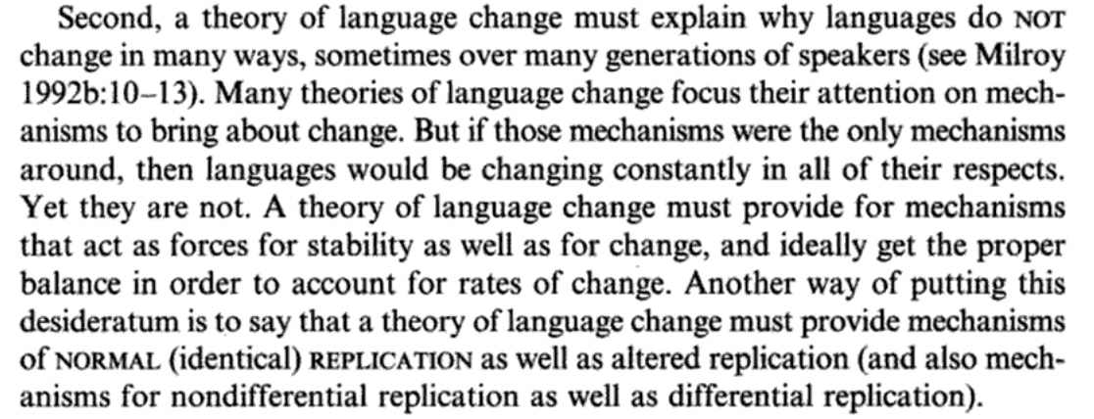
Findings
Experimental diachronics
Understanding why words change
Croft (2000, p.4)
Notes:
Evolution of cognition – leads to learning biases Learning biases shape culture

Slide 30
Findings
Experimental diachronics
Understanding why words change
mum
μαμά
mama
maman
mamá
butterfly
Πεταλούδα
schmetterling
papillon
mariposa
Notes:
Evolution of cognition – leads to learning biases Learning biases shape culture

Slide 31
Findings
Experimental diachronics
Understanding why words change
Ic ne secge
(Beowolf, 900)
Ic ne sege noht
(Ormulum, 1100)
I seye not
(Chaucer, 1400)
I doe not say
(Shakespeare, 1600)
I don’t say
(Woolf, 1900)
Dukelow (2017), Newberry (2017)
Notes:
Evolution of cognition – leads to learning biases Learning biases shape culture

Slide 32
Findings
Experimental diachronics
Understanding why words change
Notes:
Evolution of cognition – leads to learning biases Learning biases shape culture

Slide 33
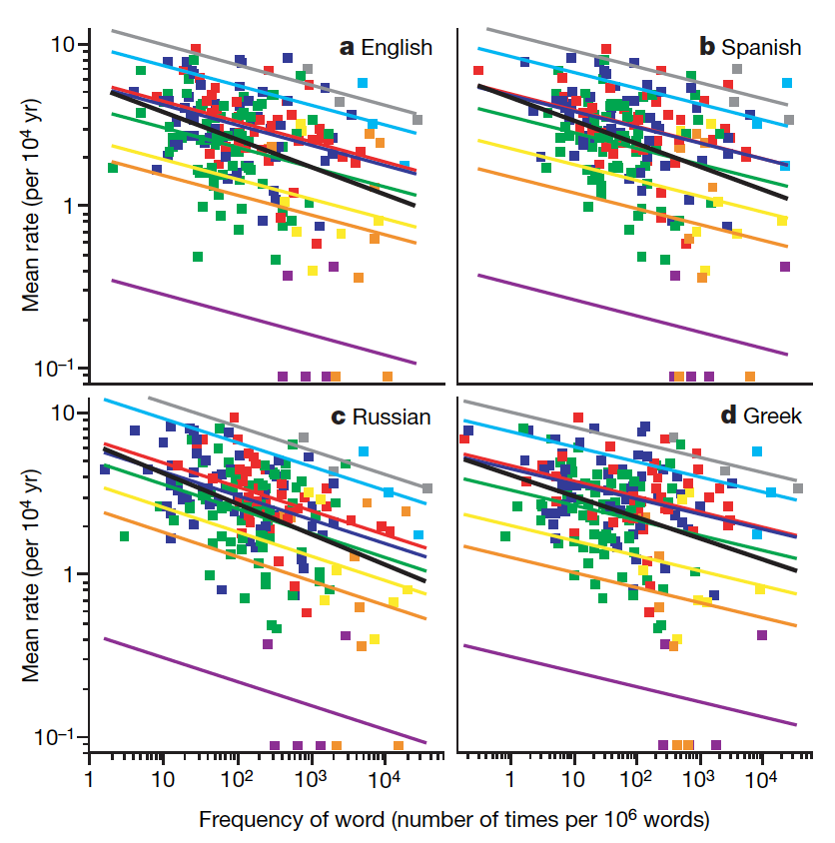
Findings
Experimental diachronics
Understanding why words change
Pagel, Atkinson & Meade (2007)
Notes:
Evolution of cognition – leads to learning biases Learning biases shape culture

Slide 34
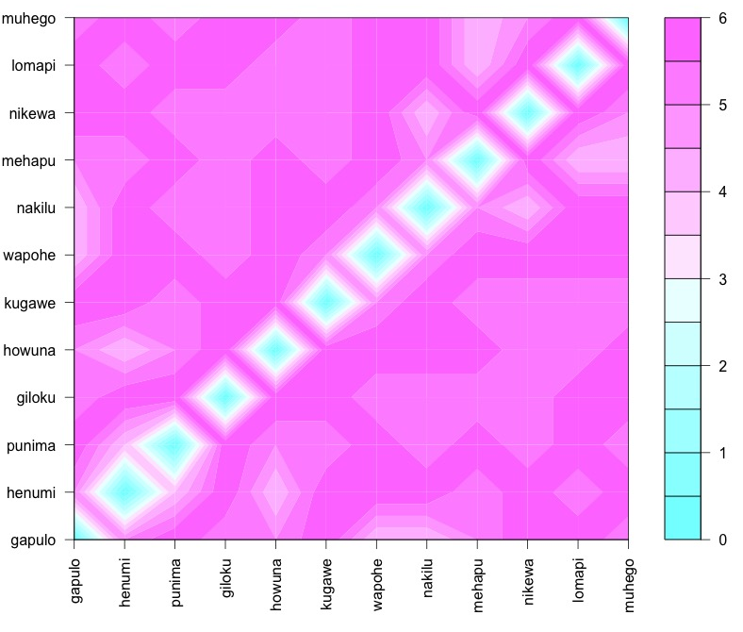
Findings
Experimental diachronics
Understanding why words change
Notes:
Evolution of cognition – leads to learning biases Learning biases shape culture

Slide 35
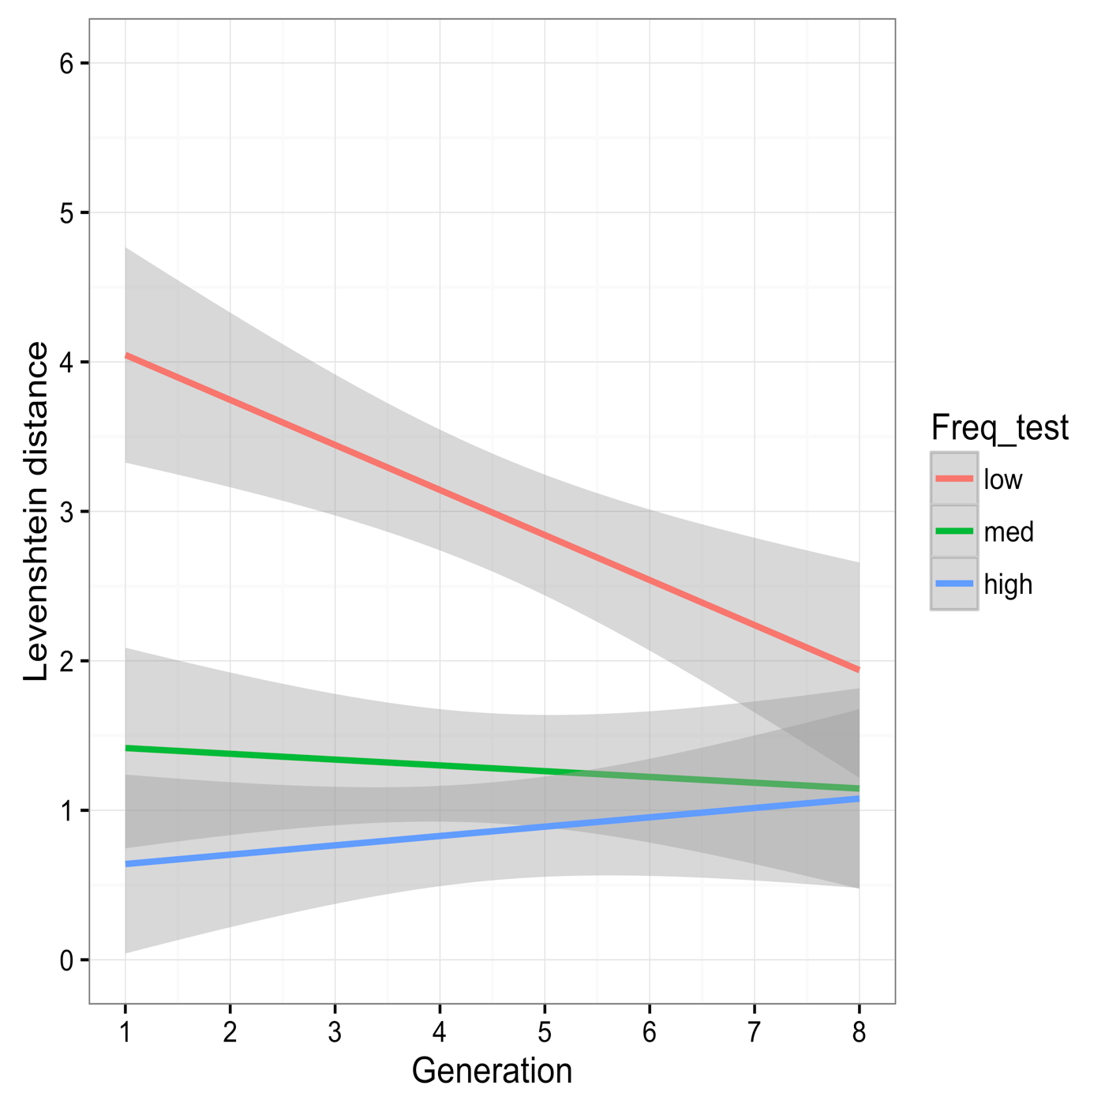
Findings
Experimental diachronics
Understanding why words change
Frequency | Generation 1 | Generation 7
low | giloku | mihewu
low | howuna | mihuge
low | kugawe | napiwa
low | lomapi | nokiwa
med | nakilu | lilipe
med | wapohe | lamupo
med | muhego | hewino
med | punima | wopehu
high | henumi | punima
high | gakulo | logopi
high | nipewa | henumi
high | mehapu | gakulo
Brand & Monaghan (in prep)
Notes:
Evolution of cognition – leads to learning biases Learning biases shape culture

Slide 36
Findings
Experimental diachronics
Understanding why words change
Calculating the likelihood of replacement or adjustment (quantitatively)
MCMC sample of the characters in the language e.g. CVCVCV
Provides 10,000 new random ‘words’ from which we can generate an average Levenshtein distance when compared to the experimental stimuli
Replacement: Levenshtein distance > 0.67
Adjustment: Levenshtein distance < 0.67
Brand & Monaghan (in prep)
Notes:
Evolution of cognition – leads to learning biases Learning biases shape culture

Slide 37
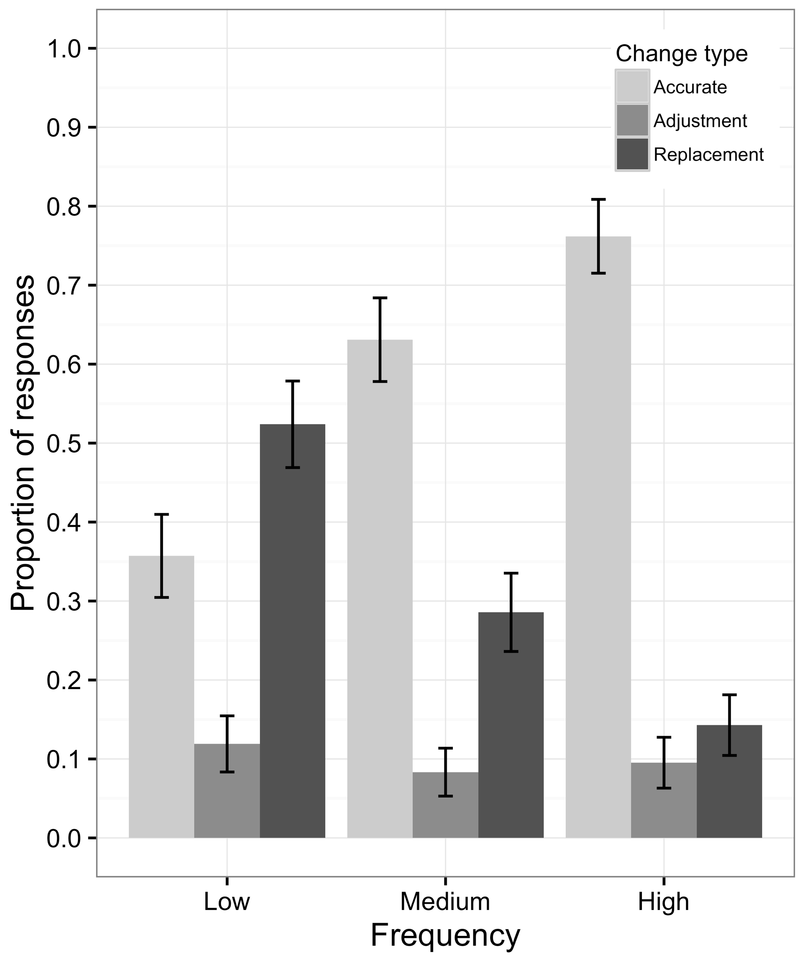
Findings
Experimental diachronics
Understanding why words change
Brand & Monaghan (in prep)
Notes:
Evolution of cognition – leads to learning biases Learning biases shape culture

Slide 38
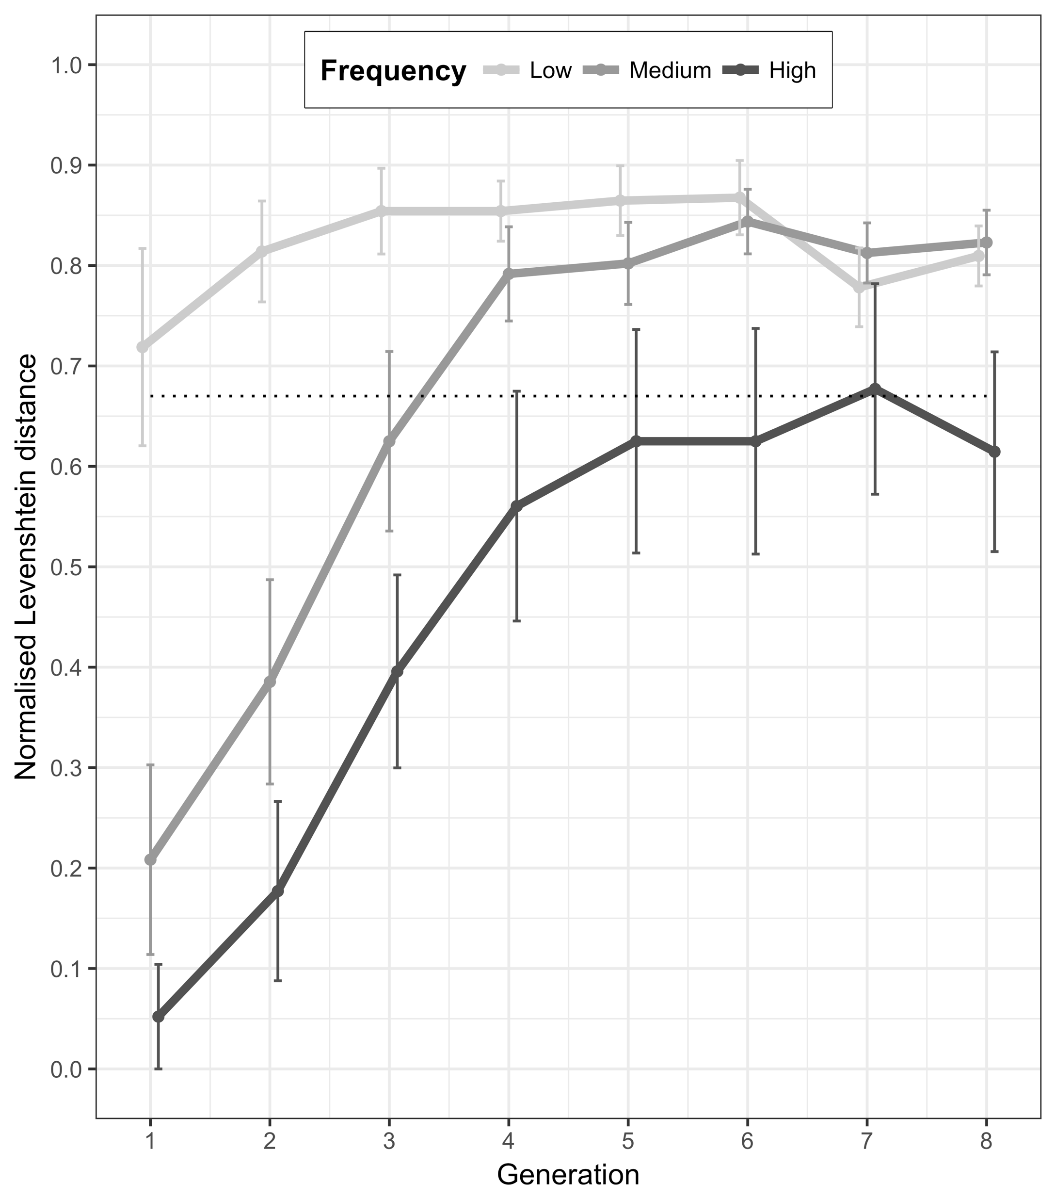
Findings
Experimental diachronics
Understanding why words change
Brand & Monaghan (in prep)
Notes:
Evolution of cognition – leads to learning biases Learning biases shape culture

Slide 39
Findings
Experimental diachronics
Understanding why words change
Word length
Semantics
Age of acquisition
Grammatical categories
Notes:
Evolution of cognition – leads to learning biases Learning biases shape culture

Slide 40
Findings
Experimental diachronics
Conclusions
What you have learnt today:
What language change and evolution is
Why we study it
How to study it
What studying it has shown us
Why multi-disciplinary research is important
Notes:
Evolution of cognition – leads to learning biases Learning biases shape culture

Slide 41
Questions/ ?
Slides available at:
https://github.com/jamesbrandscience/SSoL_2018
j.brand@lancaster.ac.uk
Notes:
Evolution of cognition – leads to learning biases Learning biases shape culture

Slide 42
Further reading
Croft, W. (2000). Explaining language change: An evolutionary approach. Pearson Education.
Christiansen, M. H., & Kirby, S. (Eds.). (2003). Language evolution. OUP Oxford.
Christiansen, M. H., & Chater, N. (2008). Language as shaped by the brain. Behavioral and brain sciences, 31(5), 489-509.
Darwin, C. (1888). The descent of man and selection in relation to sex (Vol. 1). Murray.
Fehér, O., Ljubičić, I., Suzuki, K., Okanoya, K., & Tchernichovski, O. (2017). Statistical learning in songbirds: from self-tutoring to song culture. Phil. Trans. R. Soc. B, 372(1711), 20160053.
Kirby, S., Tamariz, M., Cornish, H., & Smith, K. (2015). Compression and communication in the cultural evolution of linguistic structure. Cognition, 141, 87-102.
Pagel, M., Atkinson, Q. D., & Meade, A. (2007). Frequency of word-use predicts rates of lexical evolution throughout Indo-European history. Nature, 449(7163), 717.
Notes:
Evolution of cognition – leads to learning biases Learning biases shape culture

